Slide 1
Surfactant-Enhanced Spontaneous Imbibition in Oil-Wet, Heavy Oil Bearing Carbonate Formations
Amir Amini
Maura Puerto
Clarence Miller
George Hirasaki
April 23, 2012

Slide 2
Formation
Dead Oil: API ~ 21
Viscosity: ~150 cp (dead oil @ 40ºC)
Temperature: 40ºC
Formation Brine (FB): TDS ~ 7800 mg/L
(significant amount of divalent ions)
River Water (RW): TDS ~ 280 mg/L

Slide 3
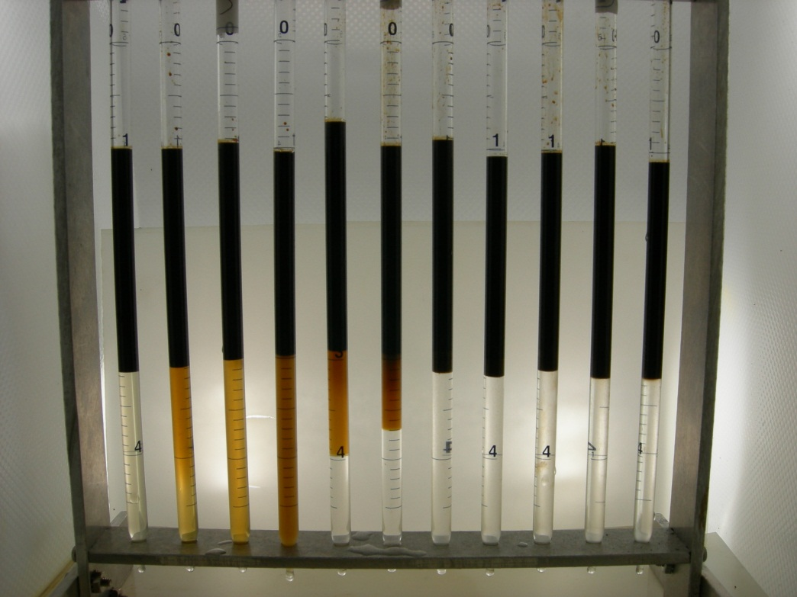
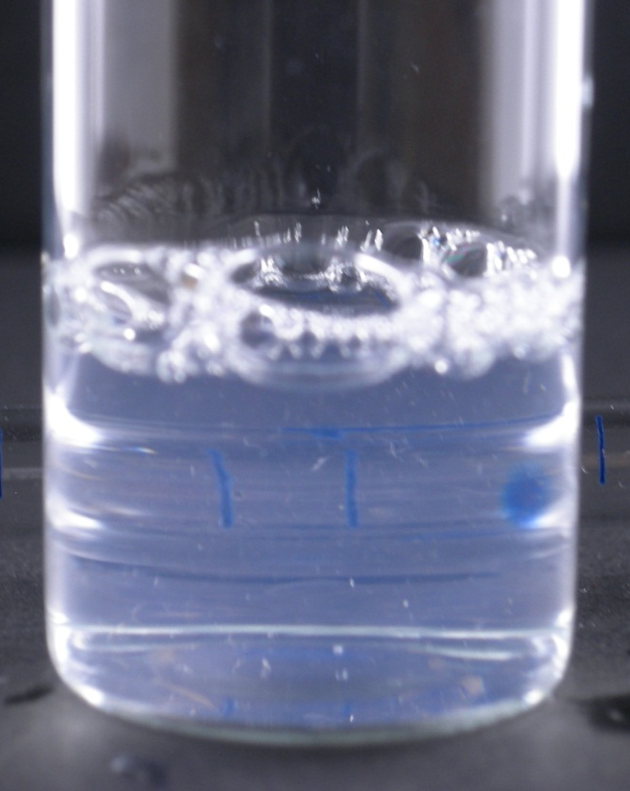
Surfactant Phase Behavior at 40ºC
BLEND: 1% S13D = iC13-13PO Sulfate + 0.1% S2= IOS 15-18
Both surfactants from Stepan
Salinity Scan: Mixtures of FB and RW
Aqueous Solution
30% FB / 70% RW
Graduated pipette on back of sample for demonstrating clarity
% FB 0 10 20 30 40 50 60 70 80 90 100
40ºC
emulsions
Clear solution suitable for studies
of adsorption and core testing
near optimal salinity

Slide 4
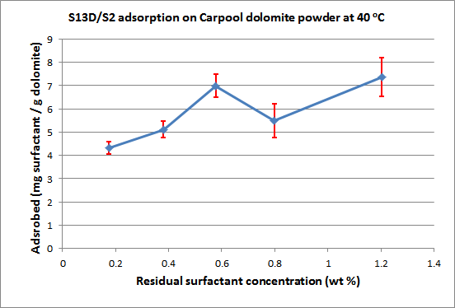
Static Adsorption of 1% S13D + 0.1% S2 in 30% FB / 70% RW
Aqueous Phase
Organic Phase
s
BET surface area = 1.8 m²/g
about an order of magnitude lower adsorption is expected in the reservoir rock

Slide 5
Overall Procedure for Spontaneous Imbibition
Insert core in core-holder to determine properties : k, ø, k_{ro} , etc.
Saturate core with formation brine (FB), k and ø.
Displace FB with dead oil to connate water, k_{ro end-point}.
Prepare coreholder (i.e., insert back pressure regulator, venting to the hood) and age at elevated temperatures for making core oil-wet.
Insert aged core in an Amott cell, first filled with the brine and next with the surfactant solution. Measure oil production in Amott cell at 40ºC as a function of time.

Slide 6
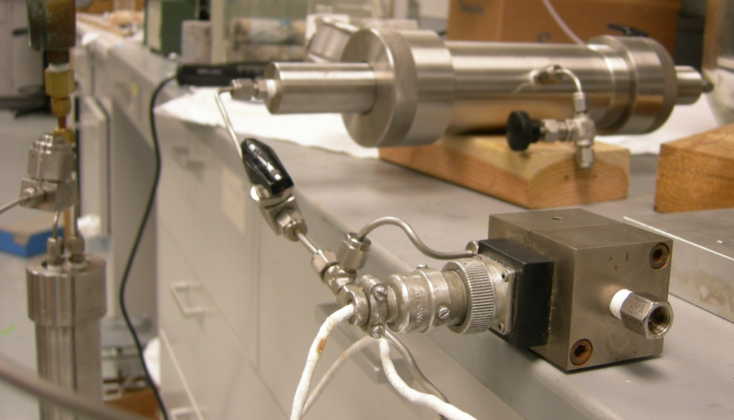

Coreflood Setup for 1.5” Silurian Dolomite and Reservoir Cores
CoreHolder
Computer
Transducer
Isco Pump
Transducer
Actual Experimental Set-Up
Filter
Core Holder
ISCO
Pump
Graduated Collector

Slide 7
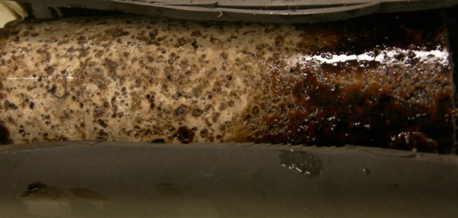
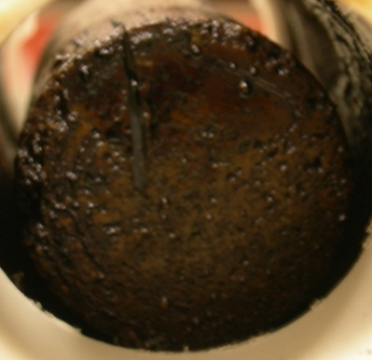
Summary of Core Preparation Results
Core | Formation | Dimensions D × L | Porosity (Ø) | Brine Permeability (k) | Irreducible Water Saturation (S_{wi}) | Endpoint Oil Relative Permeability (k_{ro})
Silurian Dolomite | Thornton | 1.5”× 3.7” | 20.9 % | 400 mD | 16.3 % | 0.6
Reservoir |  | 1.5”× 3.3” | 20.7% | 15 mD | 35 % | 0.3
Oil saturated Silurian core after being Oil saturated Silurian core after being
aged for 10 days at 100ºC (side view) aged for 10 days at 100ºC (top view)

Slide 8
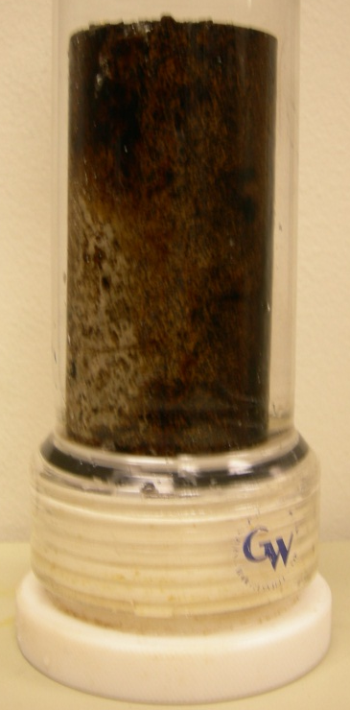
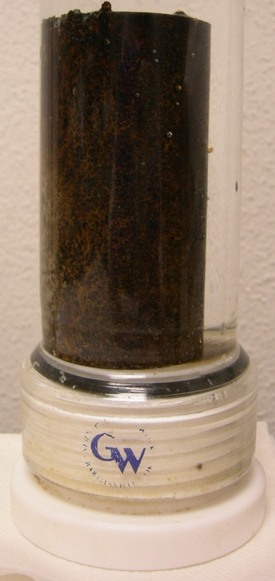
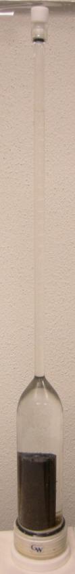
Spontaneous Imbibition Experiment
brine
meniscus
No oil was produced
Silurian core inside the After being in contact with
imbibition cell (empty cell) formation brine for 4 days

Slide 9
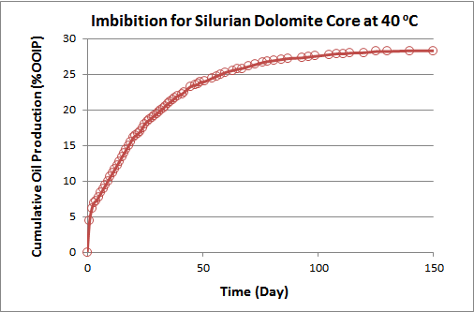
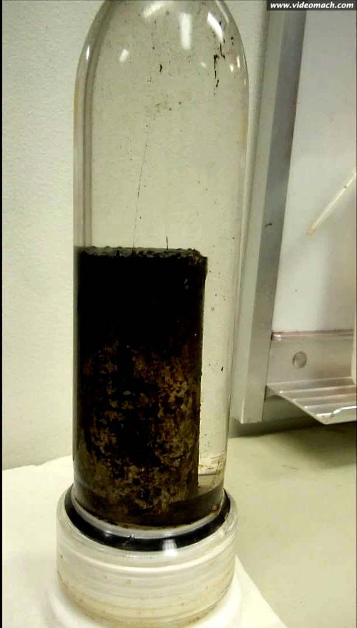
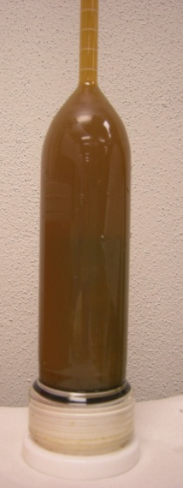
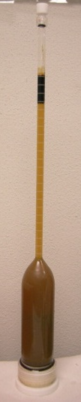
After ~ 1 min of being in
contact with the surfactant solution at room temperature
Considerable amount of oil that was
produced was not collected at top of
the Amott cell; instead it formed
oil in water emulsion or microemulsion
and remained in the body of the cell
Practically no oil was produced
from the reservoir cores
40ºC

Slide 10
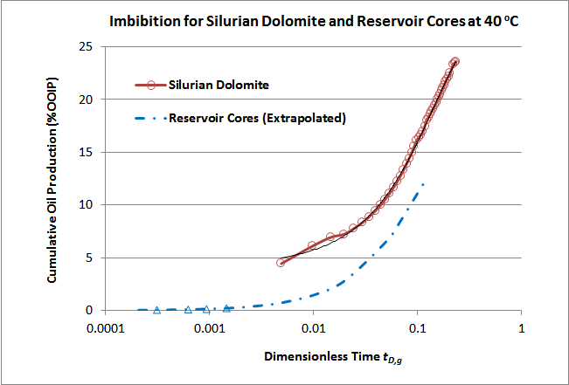
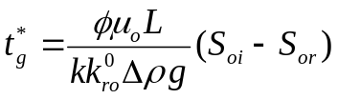
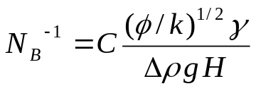

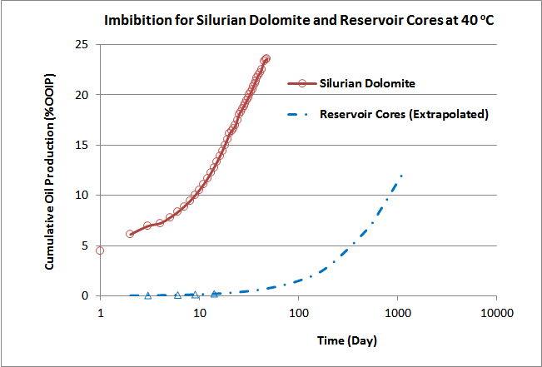


N_{B}⁻¹ : Inverse Bond Number
capillary force versus gravity
N­_{B}⁻¹ << 1 is needed for spontaneous imbibition to be gravity driven. For the reservoir cores where N­_{B}⁻¹ ­­­­­­~ 1 with initial water saturation, gravity forces are too weak to generate an upward flow of oil.

Slide 11
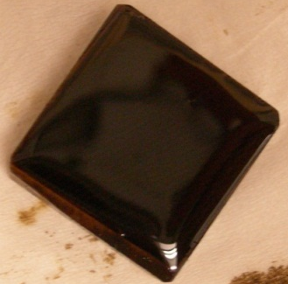
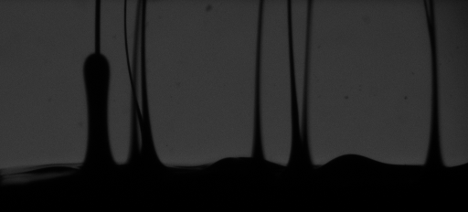
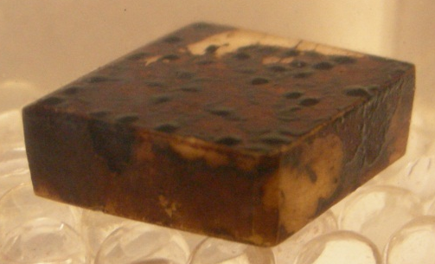

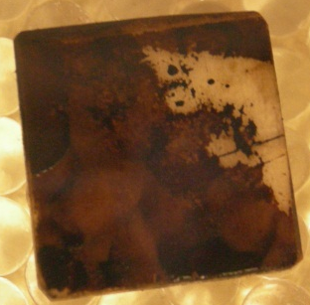
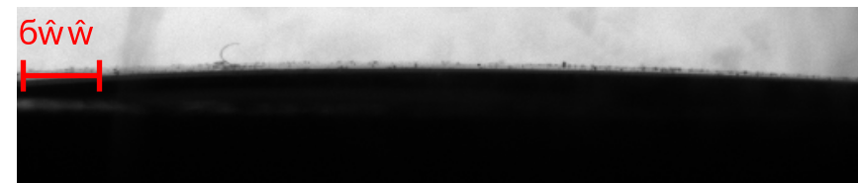
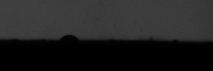
Wettability on Calcite Plates
Immersed in surfactant
formulation (T = 40ºC)
Upward streaming of oil
Initial coverage
(T = 40ºC)
After 2 hours
After 18 hours
ϴ_{A} ~ 170º
(T = 40ºC)
1mm
ϴ_{A} ~ 140º
Oil drop on an 18mm×18mm oil-wet marble plate, immersed in the formation brine.
Oil drop on the same marble plate, immersed in the surfactant formulation for 18 hours.

Slide 12
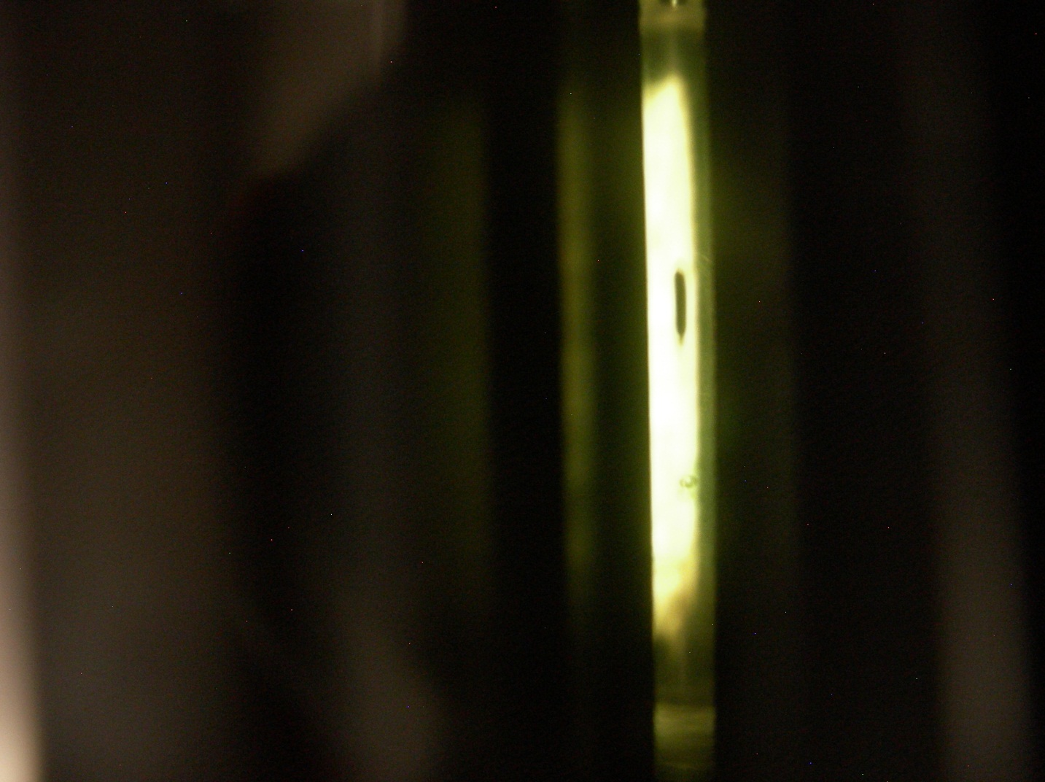

IFT Between the Surfactant Solution and the Oil
A drop of oil suspended inside the spinning
capillary tube filled with the surfactant solution
drop of oil
+ (not equilibrated)
surfactant formulation
drop of oil
+ (equilibrated)
surfactant formulation
T = 40ºC
T = 40ºC
IFT = 8.0 × 10 ⁻ ³ mN/m
IFT = 1.3 × 10 ⁻ ² mN/m

Slide 13
Summary
About 30% of the OOIP in the Silurian core was recovered.
Barely any oil was produced from the reservoir cores.
The formulation was not able to alter the wettability of initially oil-wet calcite plates to water-wet.
The measured IFT of the surfactant formulation against the deal crude oil (10⁻²mN/m) was not sufficiently low to produce the high viscosity oil from the low permeability cores.

Slide 14
Thank
You!

